Slide 1



X
Business Performance Analysis of Kimia Farma (2020–2023)
Kimia Farma - Big Data Analytics
Presented by
Ezra Satria Bagas A.

Slide 2





Ezra Satria Bagas Airlangga
Big Data Analytics
A Telecommunications Engineering graduate from Telkom University, currently pursuing a Fast Track Master’s degree in Electrical Engineering. Passionate about data analysis, AI, and machine learning, with practical experience in IoT systems, wireless sensor networks, and dashboard-based monitoring. Proficient in Python, data visualization, and exploratory analysis, and eager to apply data-driven insights to solve real-world business problems. Highly motivated to grow in the field of big data analytics and contribute to impactful decision-making.
Bandung, West Java
ezra.satria16@gmail.com
Ezra Satria

Slide 3
Courses and Certification
Intro to Data Analytics - Revou | <link certificate> <March, 2025> DSF 38 – Data Science Dibimbing | <link certificate> <April, 2025> Data Analysis Fundamental – My Skill | <link certificate> <April, 2025>

Slide 4


About Company
Kimia Farma is an Indonesian state-owned pharmaceutical company with a history dating back to 1817, when it was established by the Dutch East Indies government as the first pharmaceutical firm in Indonesia. It was later nationalized after Indonesian independence and formally became a state-owned enterprise in 1971. Today, Kimia Farma is part of the Bio Farma holding (government-owned) and is headquartered in Jakarta.
The company operates an integrated healthcare business spanning pharmaceutical manufacturing, research & development, distribution, and a nationwide retail pharmacy network. Kimia Farma also provides health services through clinics and clinical laboratories, with over 1,300 pharmacy outlets and 400 clinics across Indonesia. As a leading player in Indonesia’s healthcare industry, it plays a vital role in ensuring the availability of medicines and healthcare services for the population

Slide 5
Project Portfolio
This project aims to analyze the business performance of Kimia Farma from 2020 to 2023 using BigQuery for data processing and Looker Studio for interactive dashboard visualization. The objective is to identify transaction patterns, regional performance, customer satisfaction gaps, and product profitability across different time periods.
The project includes importing multiple datasets:
kf_final_transaction.csv (transaction details)
kf_product.csv (product information)
kf_kantor_cabang.csv (branch information)
kf_inventory.csv (inventory data)
The main focus of this project is to deliver actionable business insights from metrics such as sales, profit, customer ratings, and product performance using calculated fields like nett_sales and nett_profit.

Slide 6
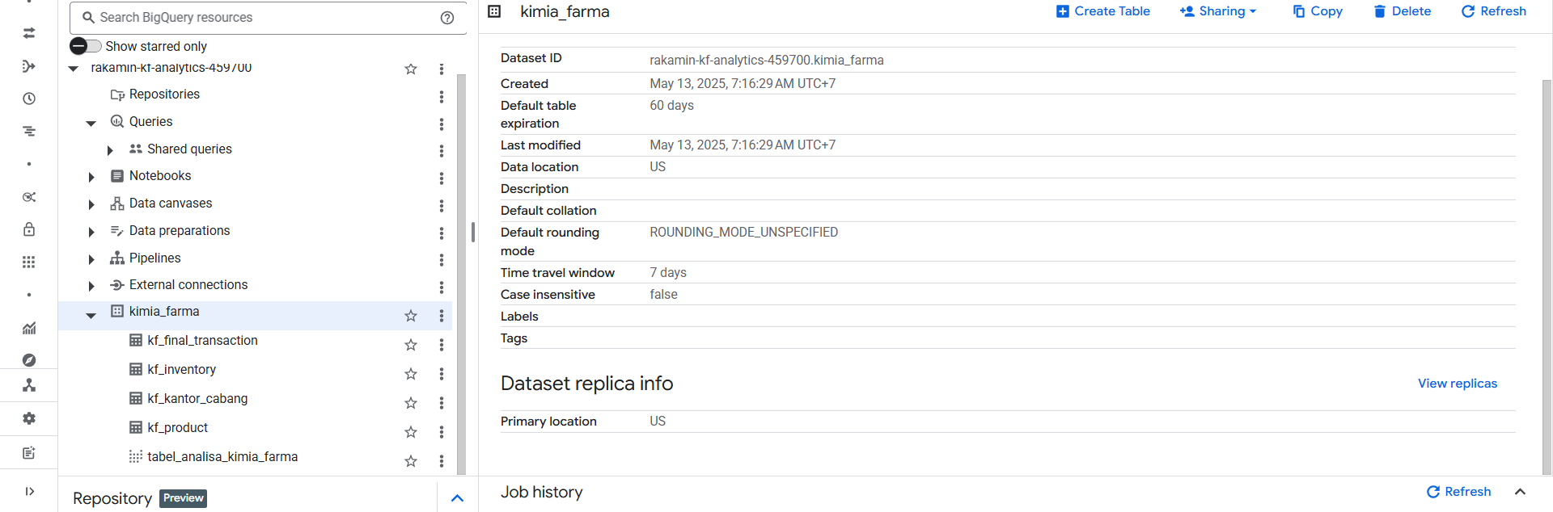
Importing Dataset to BigQuery

Slide 7
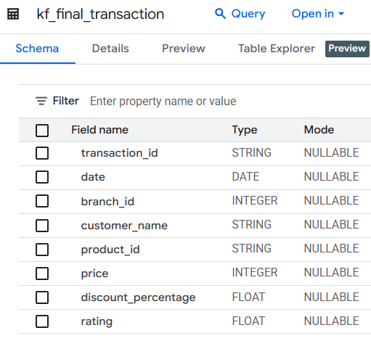
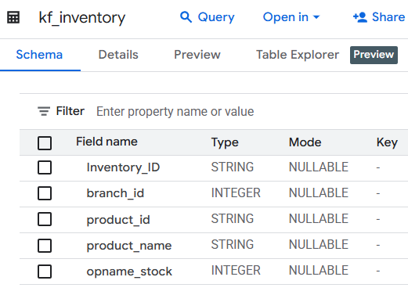
Importing Dataset to BigQuery

Slide 8
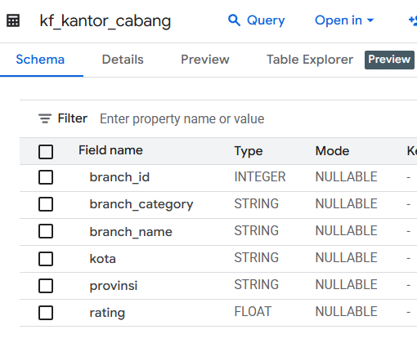
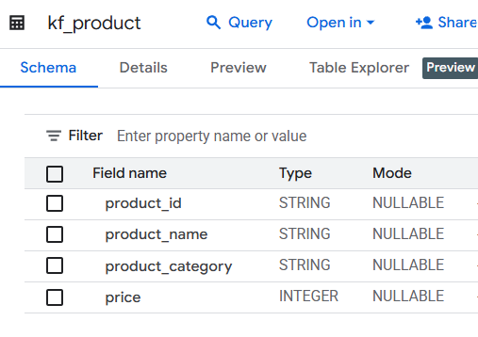
Importing Dataset to BigQuery

Slide 9
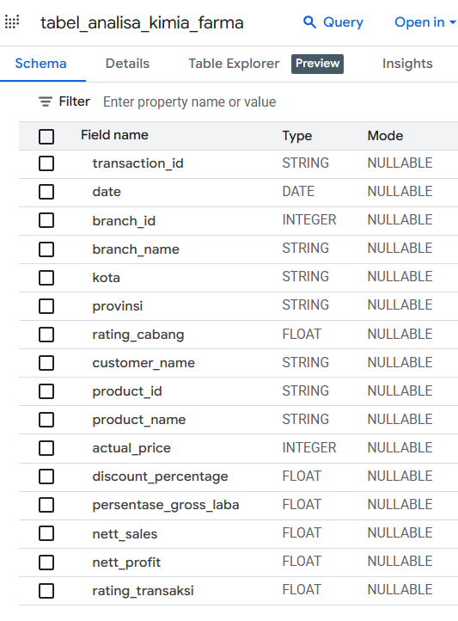
Analysis Table
An analysis table was created by joining three datasets: transactions, products, and branches. This table includes key fields such as transaction ID, date, product and branch information, and rating scores.
Additional calculated fields include:
nett_sales = price × (1 – discount percentage)
nett_profit = nett_sales × gross margin
gross margin tiered by price level
persentase_gross_laba = margin tier (10–30%)
This analysis table powers the entire dashboard and enables metric-level filtering by province, city, and branch.

Slide 10
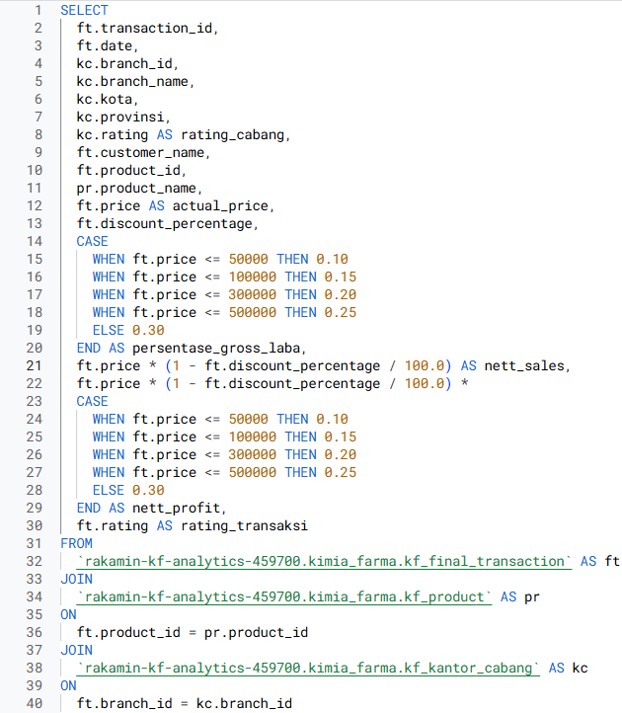
BigQuery Syntax
The SQL script uses CASE WHEN logic to dynamically assign margin percentages based on price tiers and to calculate nett sales and profit. The table is built through JOINs between transaction, product, and branch data.

Slide 11
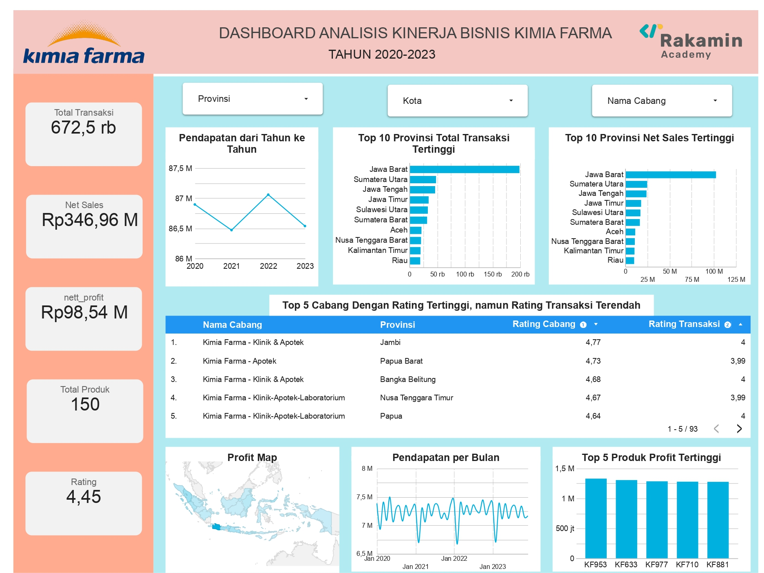
Dashboard Performance Analytics
This dashboard summarizes Kimia Farma’s business performance from 2020 to 2023. It presents key metrics such as total transactions, net sales, nett profit, product count, and average rating.
The visualizations highlight revenue trends, top-performing provinces, underperforming branches based on customer ratings, monthly revenue patterns, and the most profitable products. Users can filter by province, city, and branch to explore data interactively and support strategic decisions.

Slide 12
Submission
<link GitHub>
<link Video>
<link Dashboard>

Slide 13

Thank You
X

